Slide 1
Performance Test
Durability Test
Dynamic Flow Test
Static Flow Test
Start/Stop
Exit
Alarm Lamp
Pulse Width (ms)
Period (ms)
Total Times
Interval
Safe Upper Pressure Limit
Max Upper Pressure Limit
Real-Time Pressure
Real-Time Flow
Times of Injection

Slide 2
Performance Test
Durability Test
Dynamic Flow Test
Static Flow Test
Start/Stop
Exit
Alarm Lamp
Pulse Width (ms)
Period (ms)
Total Times

Slide 3
Performance Test
Durability Test
Dynamic Flow Test
Static Flow Test
Start/Stop
Exit
Alarm Lamp
Interval
Safe Upper Pressure Limit
Max Upper Pressure Limit
Real-Time Pressure
Real-Time Flow

Slide 4
Performance Test
Durability Test
Dynamic Flow Test
Static Flow Test
Start/Stop
Exit
Alarm Lamp
Interval
Safe Upper Pressure Limit
Max Upper Pressure Limit
Real-Time Pressure
Real-Time Flow

Slide 5
Performance Test
Performance Test
Fuel Injector
Flow Display
Alarm Lamp
Start/Stop
Exit
Pressure Display
Interval
Times of Injection
Flow Sensor
Safe Upper Pressure Limit
Start/Stop Button
Exit Button
Max Upper Pressure Limit
Pressure Sensor
Record Interval
Pressure Sensor
Pressure Sensor
Record Pressure
Sequence (8)
Pulse Length
Period
Cycles

Slide 6
Durability Test

Slide 7
Dynamic Flow Test
 | PWM | Period | Cycles | Inlet Pressure
1. Flush Injector | 5 ms | 10 ms | 10000 | 180 kPa (min)
2. Set Point | 2.5 ms | 20 ms | 6000 (min) | 270 kPa (Motor) ± 1.4 kPa
3. Measure | 2.5 ms | 20 ms | 1000? | 270 kPa ± 1.4 kPa

Slide 8
Static Flow
 | PWM | Period | Cycles | Pressure
1. Flushing Injector (option) | 5 ms | 10 ms | 10000
2. Set Point (option) | 2.5 ms | 20 ms | 6000 | 270 kPa ±1.4
3. Measure |  | 105±10 ms |  | 270 kPa ±1.4

Slide 9
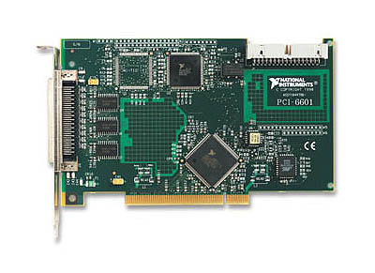
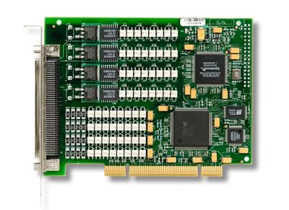
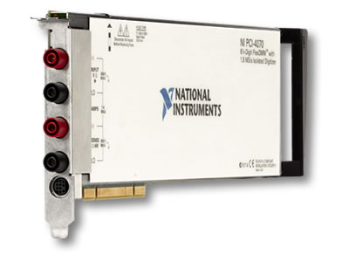
PC
FDM Tester
PCI-6601
RTSI
PCI-6515
RS232
Fuel Injector Tester
Pressure Sensor
PCI-4070
Flow Sensor
Pump Fuel Line
Injector

Slide 10
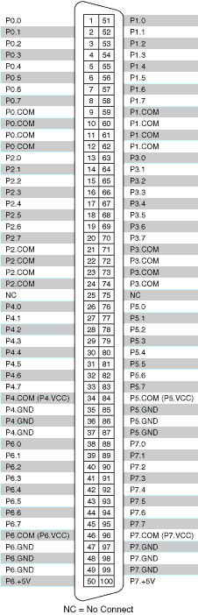
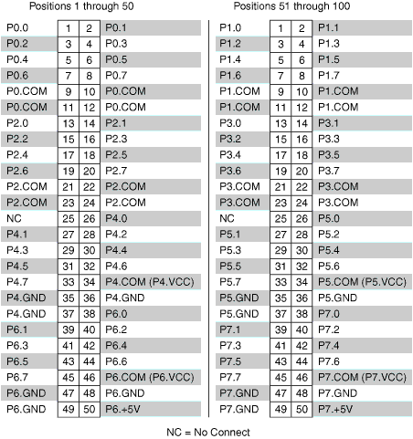
PCI-6515
NI 6515 Pin Assignments for the R1005050 Cable
NI 6515 Pin Assignments for the SH100-100-F Cable

Slide 11
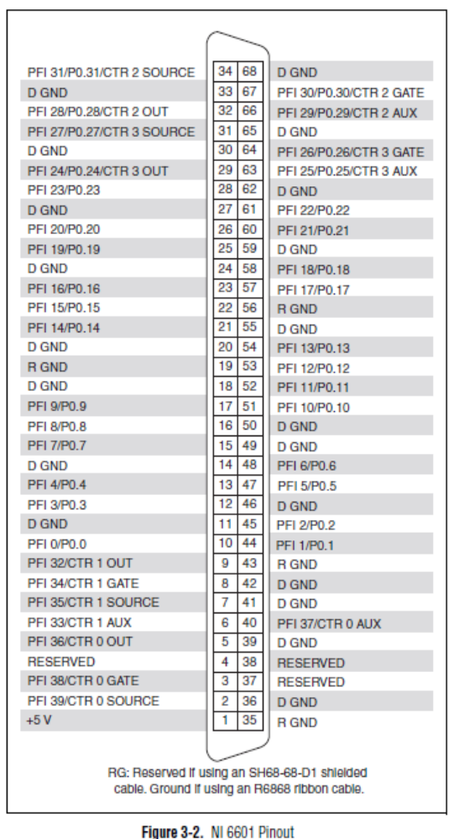
PCI-6601
Up to 32 ports can be used as DIO ports
8 dedicated Digital Input/Output ports
PFI <8..32> can be used as DIO ports when not used by counters/timer I/O signals
CTRL Pins control counters
Power rating for +5V pin is +4.65V to +5.25V
*Denotes dedicated DIO

Slide 12
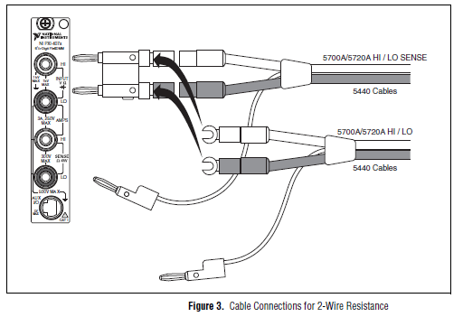
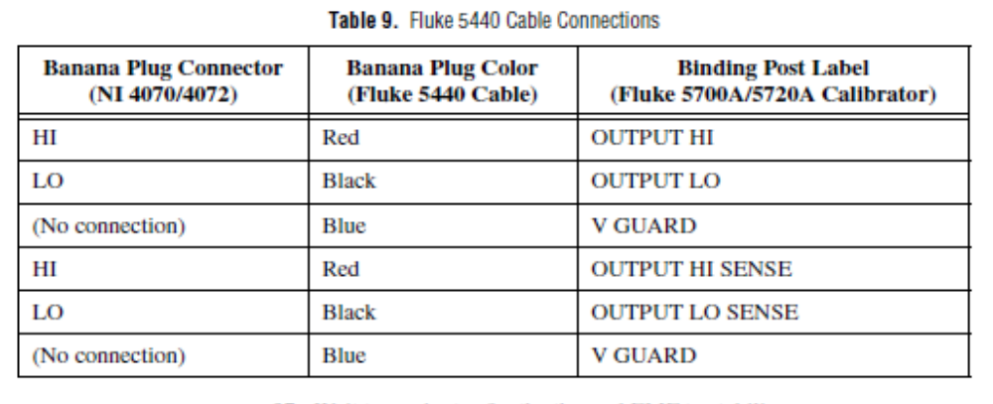
PCI-4070
5V MAX

Slide 13
No Filter Tester Diagram
250 OHMS
Current Signal
Pressure Sensor
12V Power
Adventech DAQ card 4711A USB
Pump Fuel Line
Voltage Signal
Fuel Injector
PC Software
Relay
PCI-6515 DAQ Card
PWBA
14V Power
Counter Card PCI-6601

Slide 14
Pressure Sensor
2
12V
250 OHMS
Signal
Card
GND
Flow Sensor
3
0-100mv to 0-5v amplifier
Pump
2
5v to 14v amplifier
FCA
4 Injectors
8
2 Injectors
4

Slide 15
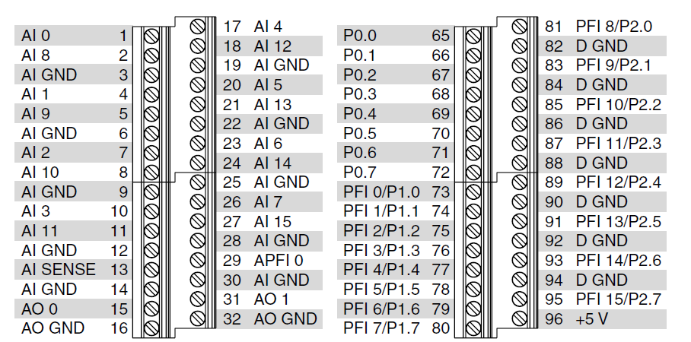
Already in Use

Slide 16
1
2
3
4
5
6
7
8
9
10
11
12
13
14
15
16
17
18
19
20
21
22
23
24
25
26
27
28
29
30
31

